Slide 1
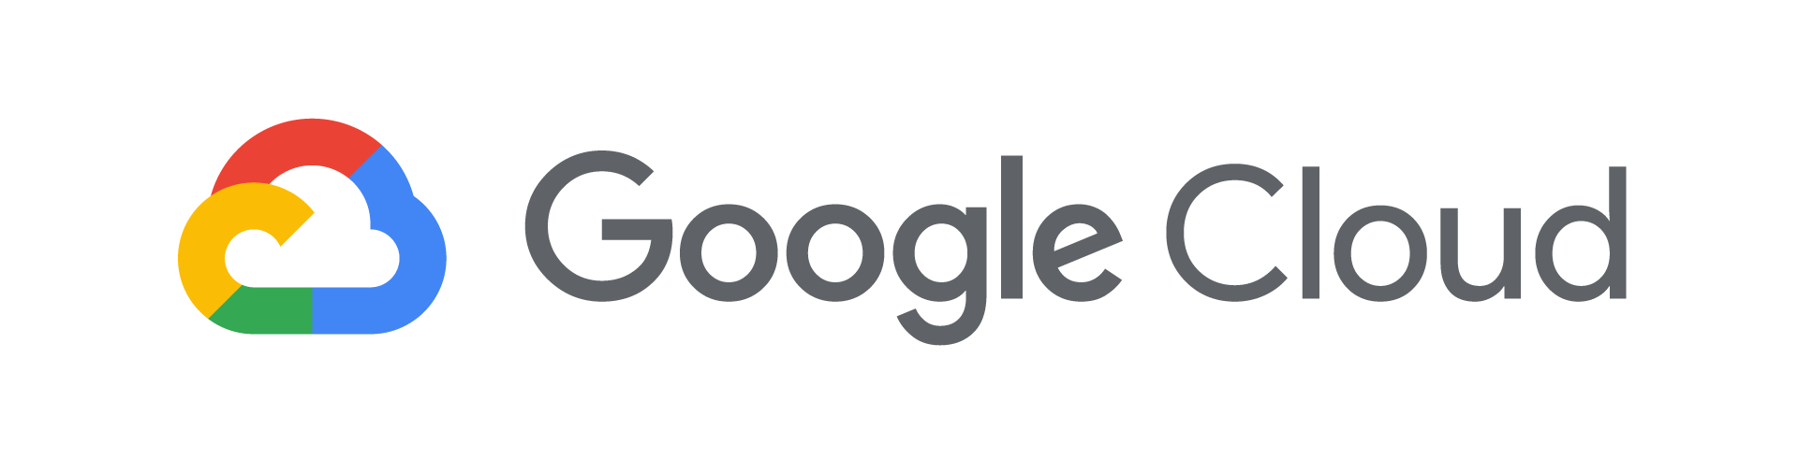
Design and Process Workbook

Slide 2
1a. Defining Your Case Study
Come up with a case study. Then fill in the next slide.
Examples:
Online Banking Portal
Ride sharing application (like Uber)
Online shopping site
Something else...

Slide 3
1b. [Case Study Name Here]
Brief description:
List a few main features:
List roles of typical users:

Slide 4
2a. Writing User Personas
Create two user personas that describe typical users of your application. Add a new slide for each persona.
Example persona:
Jocelyn is a busy working mom who wants to access MegaCorp Bank to check her account balances and make sure that there are enough funds to pay for her kids' music and sport lessons. She also uses the web site to automate payment of bills and see her credit account balances. Jocelyn wants to save time and money, and she wants a credit card that gives her cash back.

Slide 5
2b. Writing User Stories
Create three user stories for the roles you defined earlier.
Create a new slide for each user story.
Example user story:
Balance Inquiry
As a checking account holder, I want to check my available balance at any time of day, so that I am sure not to overdraw my account.

Slide 6
3. Defining SLIs and SLOs
Based on requirements of your case study, fill in the table below with SLOs and SLIs.
User Story | SLO | SLI
Balance Inquiry | Available 99.95% | Fraction of 200 vs 500 HTTP responses from API endpoint measured per day
Balance Inquiry | 95% of requests will complete in under 300 ms. | Time to last byte GET requests measured every 10 seconds aggregated per minute

Slide 7
4. Design Microservices for Your Application
Draw a diagram showing your application's microservices and their connections.
Accounts
Service
Products
Service
Accounts
Database
Web
UI
Customer
Service
Reporting Service
Mobile
UI
Analytics
Service
Customer
Database
Data Warehouse
Auth
Service

Slide 8
5. Designing REST APIs
Fill in the table with your services and their resources and operations.
Service name | Collections | Methods
Account Service | transactions | list deposit withdraw transfer

Slide 9
6. Defining Storage Characteristics
Fill in the worksheet of required storage features.
Service | Structured or Unstructured | SQL or NoSQL | Strong or Eventual Consistency | Amount of Data (MB, GB, TB, PB, ExB) | Read only or Read/Write
Account Service | Structured | SQL | Strong | GB | Read/Write
Service | Structured or Unstructured | SQL or NoSQL | Strong or Eventual Consistency | Amount of Data (MB, GB, TB, PB, ExB) | Read only or Read/Write
Account Service | Structured | SQL | Strong | GB | Read/Write

Slide 10

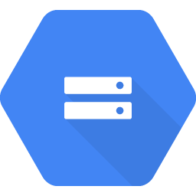

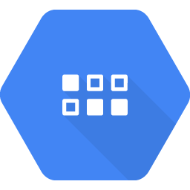




7. Choosing Google Cloud Storage and Data Services
Choose the Google Cloud storage products for each service.
Service | Persistent Disk | Cloud Storage | Cloud SQL | Firestore | Cloud Bigtable | Cloud Spanner | BigQuery
Account Service |  |  | X
Service
Account Service |  |  | X
Persistent Disk
Cloud Storage
Cloud SQL
Firestore
Cloud Bigtable
Cloud Spanner
BigQuery

Slide 11
8a. Defining Network Characteristics for Your Services
Fill in the worksheet of required network features.
Service | Internet facing or Internal only | HTTP | TCP | UDP | Multiregional?
account | Internal only |  | Yes |  | No

Slide 12
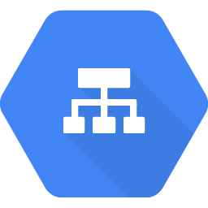
8b. Select the Load Balancers for Your Services
Choose the Google Cloud load balancer products for each service.
Service | HTTP | Cloud TCP | UDP
Account |  | X
Service
Account |  | X
HTTP
TCP
UDP

Slide 13



9. Diagramming Your Network
Draw a diagram that depicts how your services will communicate over the network. Include regions, zones, load balancers, CDN, and DNS if applicable.
Products Service
Accounts Service
Products Database
Accounts Database
UI
HTTPS
Global HTTP Load Balancer
Customer Service
Customer Database
Auth Service
Third-Party
VPC

Slide 14
10. Designing Reliable, Scalable Applications
Even if some service is down, we want the web frontend of our application to be available nearly all the time. We also want the website to be fast with very low latency to users all over the world. Draw a diagram that depicts how we can achieve this using Google Cloud services.
us-east-1
us-central-1
us-central1
us-central1-a
us-central1-a
Orders Service
Cloud SQL
Inventory Service
Analytics Service
BigQuery
UI
HTTPS
TCP Load Balancer
us-central1-b
HTTP
Global Load Balancer
Orders Service
Failover
Inventory Service
Firestore
us-central1-b
UI
Multi-regional Cloud Storage bucket for backups

Slide 15
11a. Disaster Recovery Scenario
You've deployed for high availability by replicating resources in multiple zones. However, to meet regulatory requirements, you need a plan to recover from a disaster that brings down the entire region. The current architecture is depicted below. On the next slide, create a plan to bring up your application in another region if your main region is down.
us-central-1
us-central1-a
Orders Service
Cloud SQL
Inventory Service
Analytics Service
BigQuery
TCP Load Balancer
us-central1-b
Accounts Service
Failover
Products Service
Firestore

Slide 16
11b. Service Disaster Recovery Scenarios
Write a high-level list of possible scenarios.
Service | Scenario | Recovery Point Objective | Recovery Time Objective | Priority
Ratings Service | Programmer deleted all ratings accidentally | 24 hours | 1 hour | Med
Orders Service | Orders database crashes | 0 (can’t lose any data) | 2 minutes | High

Slide 17
11c. Resource Disaster Recovery Plans
For each scenario, fill in the table.
Resource | Backup Strategy | Backup Location | Recovery Procedure
Ratings Database | Daily automated backups | Multi-Regional Cloud Storage Bucket | Run Restore Script
Orders Database | Failover replica plus daily backups | Multi-zone deployment | Automated

Slide 18
12. Modeling Secure Google Cloud Services
Draw a diagram that depicts how you will secure your services. Include firewalls, IAM roles, service accounts and network resources as appropriate.
Custom VPC
Cloud Armor Block blacklisted IPs
Firewall Rules:
Allow HTTPS from 0.0.0.0/0
Allow SSH from known sources
HTTPS
Subnets:
us-central1
us-east1
HTTP
Global Load Balancer

Slide 19
13. Cost Estimating and Planning
Use the pricing calculator to determine the cost of your microservices.
Service name | Google Cloud Resource | Cost
Accounts | Cloud SQL | $574.71/month

